Slide 1
AI Football
Program AI algorithm to control you football team, shoot goals and win

Slide 2
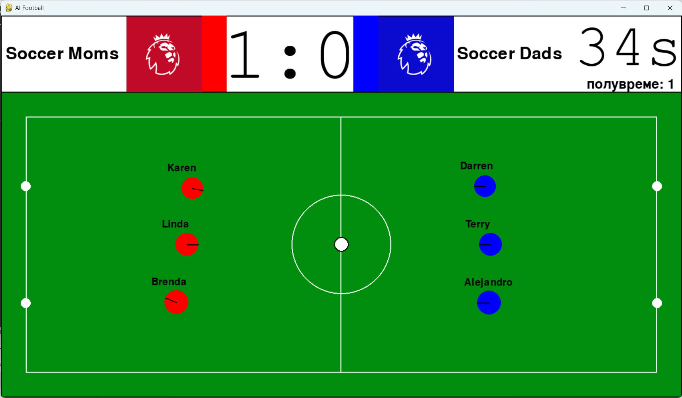
Purpose
Introduction
How the game works?
How to control your team?
How to start?
Rules
Suggested software

Slide 3
Introduction
3 vs. 3 Football game
Match duration: 90 seconds
Everyone is a player and a goalkeeper at the same time
Each team needs to control each one of their 3 players

Slide 4
How the game works?
guide or shoot
Each player has the following attributes:
mass: heavier players can push out lighter players
radius: larger players take up more space
acceleration: player top acceleration
speed: player top speed
shoot power: ball travels further and faster
A player may choose to:
guide the ball: pushes the ball in the direction of movement
shoot the ball: shoots the ball in the direction of movement
radius

Slide 5


How the game works?
$$α$$
Player movement is determined by a vector:
Angle($α$): direction of movement
Force(F): acceleration = F / mass
The player accelerates in the appropriate direction determined by the angle ($α$), with the appropriate acceleration determined by the force (F)
F

Slide 6
How the game works?
Field coordinates will never change
Post coordinates will never change
Use these coordinates as constants to guide your players
Find this coordinates in “AIFootball.py”
F
Fixed coordinates

Slide 7
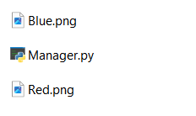
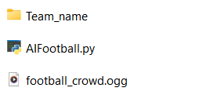
How to control your team?
“AIFootball.py” is the official simulation script
“Team_name” folder should be named according to each team
“Team_name” contains “Manager.py” script and picture of your team logo
F
F

Slide 8
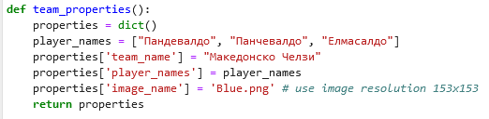
How to control your team?
“Manager.py” contains a function named team_properties()
Use this function to declare:
team name
player names
team logo
F

Slide 9
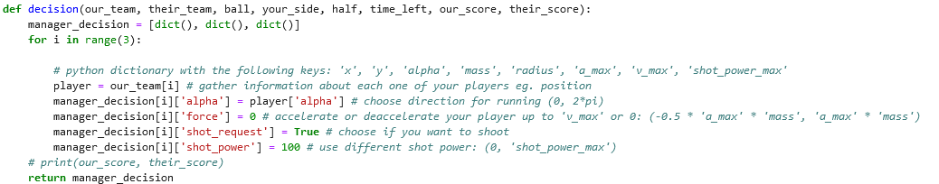
How to control your team?
“Manager.py” contains a function named decision()
Use this function to:
obtain game data
control players
F

Slide 10

How to control your team?
Arguments:
our_team: list of players in our team
their_team: list of player in their team
ball: ball information
your_side: “left” or “right” side of the field
half: “true” or “false” first or second half of the game
time_left: till end of half time
our_score: number of goals given by your team
their_score: number of goals given by opponents’ team
F

Slide 11
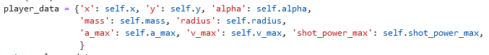
How to control your team?
Arguments:
List of players in “our_team” and “their_team” contains information about each player
F

Slide 12
How to control your team?
Use the following arguments to control your player:
‘alpha’: player movement direction
‘force’: use this force to accelerate your players
‘shot_request’: should I shoot or not?
‘shot_power’: how powerful should I shoot?
F

Slide 13
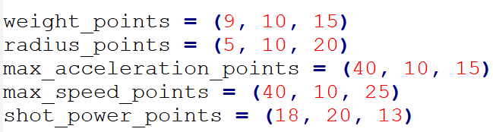
Player attributes customization
Each player has different attributes such as: max. speed, max. acceleration etc.
Each teams may customize the attributes of each player
Maximum points that can be given to each player is total of 120
Maximum points that can be used by each team is total of 270
Customize your players according to your own needs
F

Slide 14
How to start?
Our recommendation:
Use Simple Reflex Agents
If necessary turn off the render inside AIFootball.py
Use Learning Agents
F

Slide 15
Rules
You may only use Python 3.8.8
You may use whichever libraries you want as long as they are compatible with Python 3.8.8
Please inform the organizers for a list of libraries you require before finals
F

Slide 16
Suggested software
All scripts were tested in Anaconda 4.13.0 using Python 3.8.8
You may use whichever Python distribution you like, but we recommend using Anaconda
Required libraries: pygame, numpy, os, time, random

Slide 17
Questions?

